Slide 1
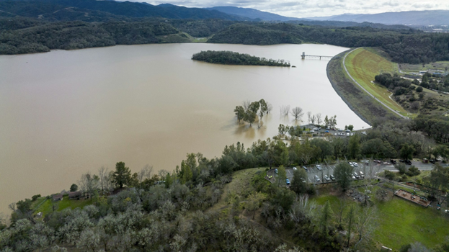

Coyote Valley Dam
General Investigation Study
Alternative Delivery Options
June 11, 2026

Slide 2
Agenda
Current Status and Federal Funding Update
Why Alternative Pathways Need to Be Evaluated
Overview of Potential Strategies
Recommended Decision-Making Framework
Proposed Schedule and Next Steps

Slide 3
Current Status
The Study was paused by USACE on October 20, 2025 due to lack of federal funding.
Neither the FY26 USACE General Investigations Workplan nor the FY27 President’s Budget included funding to continue the Study. Congressman Huffman submitted a request for $1.8M for the Study.
Current federal priorities are not focused on advancing new water supply projects, and USACE is generally reducing the overall size and scope of its planning portfolio.
The current Administration is generally supportive of maintaining continued Potter Valley Project diversions and is not prioritizing actions that would eliminate or substantially reduce those diversions.

Slide 4
Coyote Valley Dam Feasibility Study Expectations
Original Expectations When Cost-Sharing Agreement Was Executed | Expected Changes Based on New USACE Planning Policy
Estimated 5-year study schedule | Study limited to 3-year schedule
Estimated total study cost of $6M to $8M | Budget limited to $3M
Full array of alternatives considered for authorization / construction | Limited array of options considered for authorization / construction; More constrained planning and evaluation process under revised policy framework

Slide 5
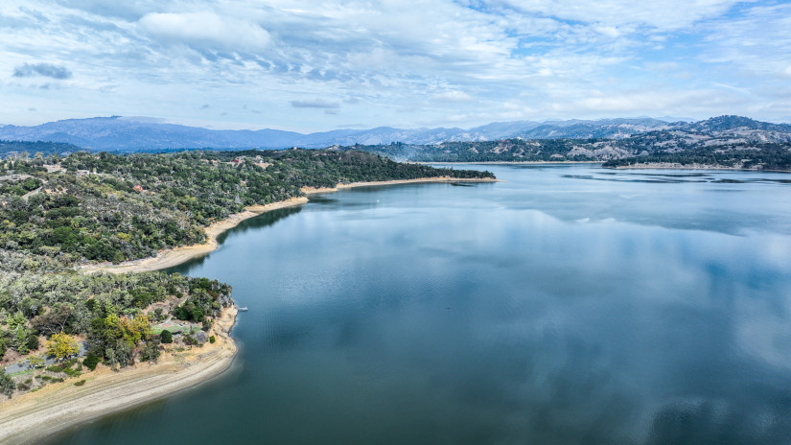
Evaluating More Predictable and Achievable Project Pathways
Existing federal study and funding pathways may no longer provide a predictable or timely path toward project advancement.
We should evaluate whether alternative implementation, planning, funding, or governance pathways could provide a more achievable and reliable path toward advancing regional water supply objectives and realizing project benefits sooner.

Slide 6
Potential Strategies
Strategy 1 – Traditional USACE-Led Feasibility Path
Strategy 2 – Non-Federal-Led Feasibility Path
Strategy 3 – Alternative Planning and Operational Studies
Strategy 4 – Direct Advancement Toward Implementation

Slide 7
Recommended Decision-Making Framework
Several alternative pathways were developed under each strategy.
  Each alternative has different tradeoffs related to funding, schedule, riskiness, and complexity.
  Some alternatives involve a higher degree of uncertainty due to limited precedent, and evolving policy considerations.
  Alternatives determined to be clearly infeasible, impractical, or inconsistent with IWPC goals will be screened out from further consideration.
Remaining alternatives will be evaluated using criteria designed to meet IWPC’s objectives.

Slide 8
Objectives and Criteria
Objective | Example Criteria
Secure Sustainable Water Supply | Maximize Water Storage
Synchronize Water Storage Availability w/ NERF Delivery | Schedule Certainty
Maximize Federal and State Cost-Sharing | Funding Availability and Reliability
Deliver a Successful and Durable Project | Environmental Impact/Benefit, Technical Complexity

Slide 9
Proposed Schedule
July 9
  Review Alternatives
  Discuss Screened Alternatives
  Review Evaluation Criteria
August 13
  Review Evaluation Results
September 10
  Discuss Implementation Plan

Slide 10
Questions

