Slide 1

Mendocino County inland water and power commission
Next Steps - storage

Slide 2
Options under consideration for additional storage in the Russian River watershed
USACE study of Lake Mendocino (with potential pipeline for delivery to Potter Valley) – being studied
Tributary storage – concept study completed
Lower Valley on-stream storage – concept study completed
In-valley pond storage – concept study completed
Conjunctive use – concept study completed
Pump back from Lake Mendocino – concept study completed
  Note: Costs associated with “concept studies” are typically -50%/+100%

Slide 3
USACE Storage Project
Pros and COns
Pros:
  Federal nexus, if identified, could bring federal funding participation
  Could be a large project, plenty of storage for users downstream of Lake Mendocino
Cons:
  Modest to no local control of timing of study
  Expensive to study, estimated local share $4M in 4 years
  No guarantee of identifying a project
  Currently on hold due to lack of federal prioritization, restart timing uncertain
Next Steps & Next Costs
  Press for federal engagement
  $4M over 4-5 years

Slide 4
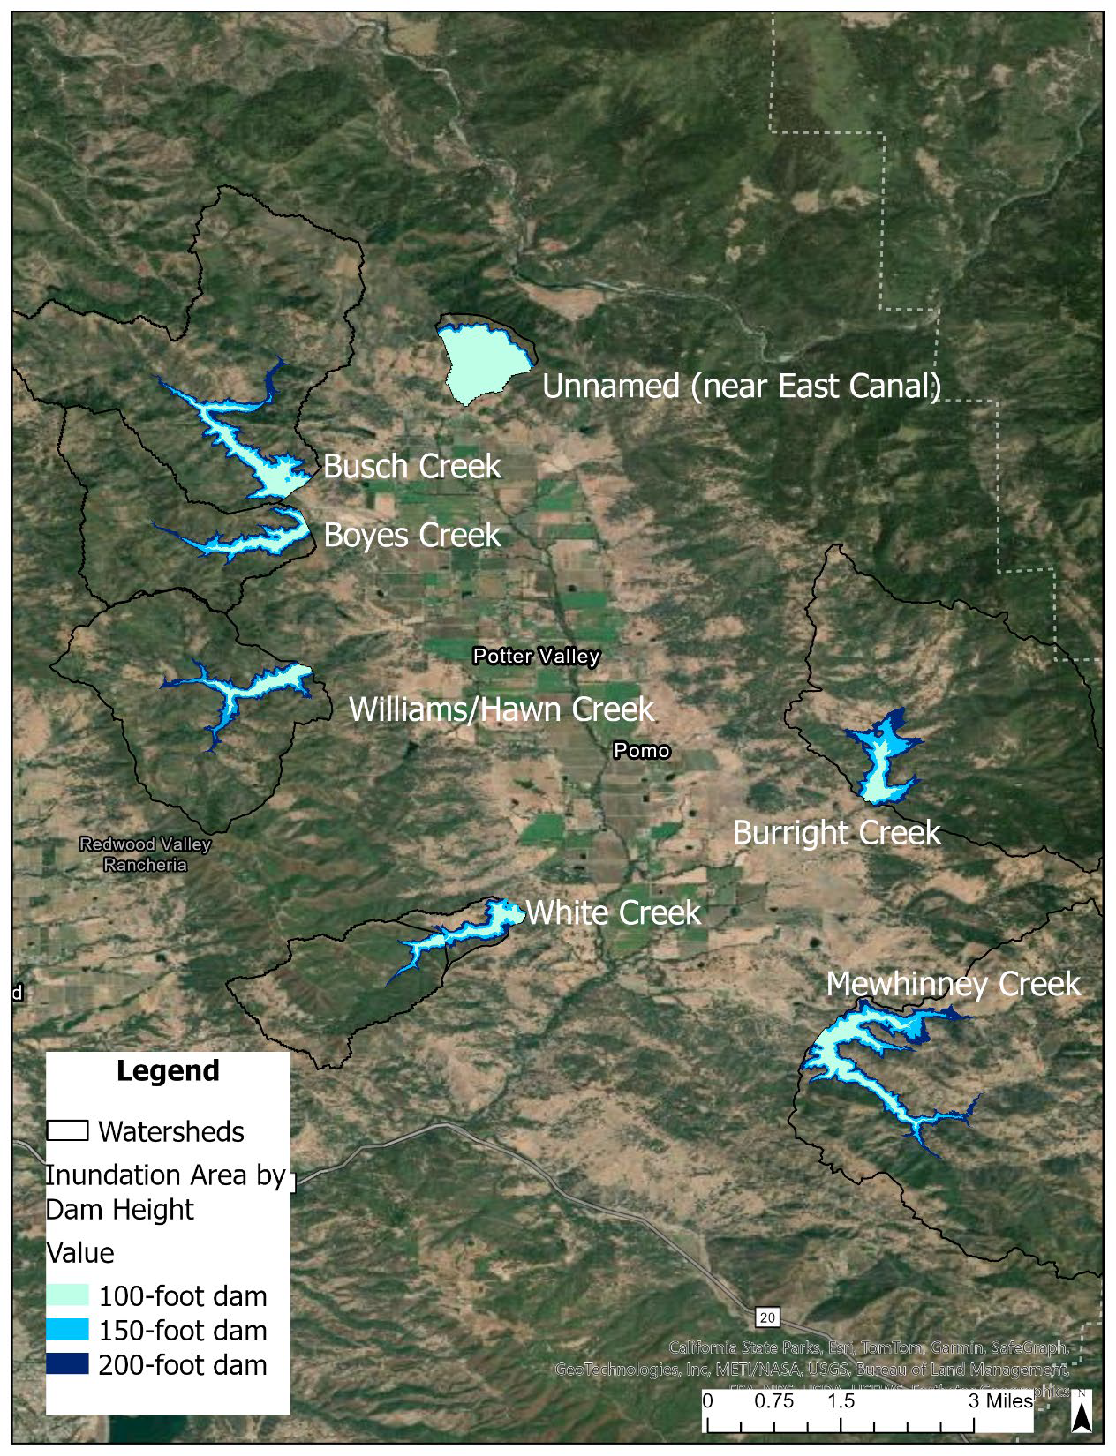
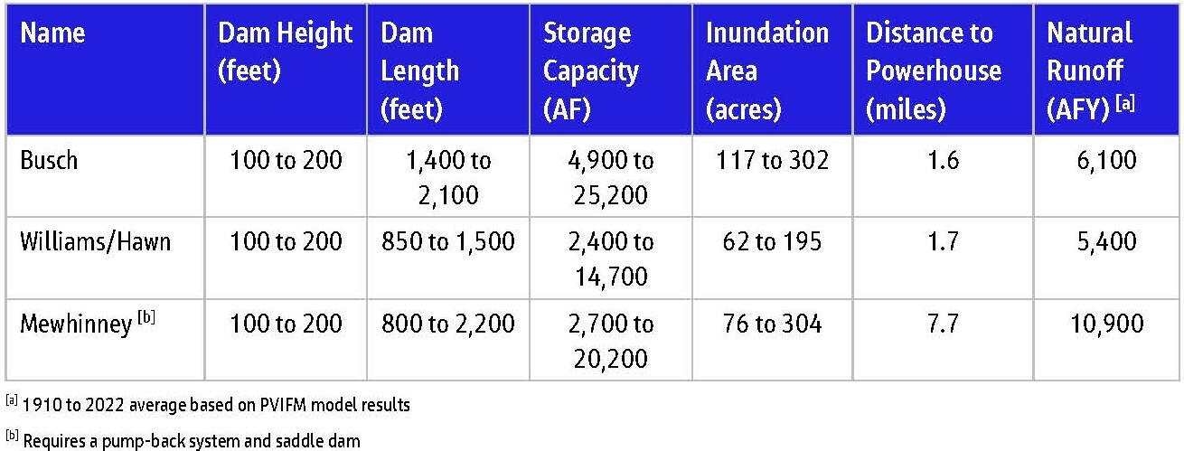
Tributary Storage
7 major tributaries evaluated, largest three were selected
Each simulation utilized historical hydrologic conditions between 1911 and 2022 and annual water supply demands on the order of 6,000 acre-feet in Potter Valley typically occurring between March through October each year.

Slide 5
Tributary Storage
Potential Costs, Pros & Cons
Costs:
  Preliminary capital estimate of $125M to $250M, plus costs of piping for fill and distribution
Pros
  Potential for pressure fill from NERF, then gravity delivery to downstream
  Could be larger than PVID needs, so this would provide potential regional storage
  Supplemental to Lake Mendocino study, and on separate timeline than USACE work
Cons
  Likely expensive on an acre-foot basis
  Complex to permit and potential water rights issues
Next Steps & Next Costs
  Engage engineering consultant for advanced studies
  First phase $500k, next phase $500k - $1000k

Slide 6
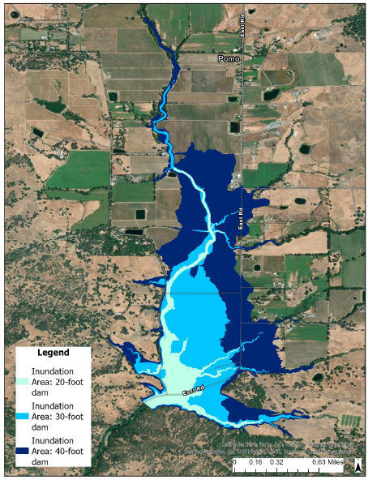
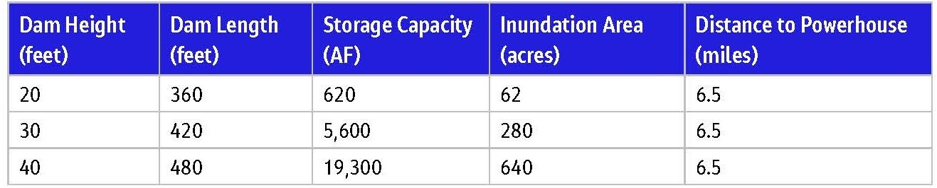
Lower Valley
On-Stream Storage
Jacobs evaluated 20, 30, and 40 ft dam heights

Slide 7
Lower Valley On-Stream Storage Potential Costs, Pros & Cons
Costs:
  Preliminary capital estimate of $115M to $220M, plus cost of pressure distribution upstream of dam
Pros
  Gravity fill, including NERF and in-valley runoff sources
  Could be larger than PVID needs, so could potentially provide regional storage for other downstream users
  Supplemental to Lake Mendocino, and on separate timeline than USACE work
Cons
  Likely expensive on a per acre-foot basis
  Complex to permit; land taking; potential water rights issues; potential water quality concerns
Next Steps & Next Costs
  Engage engineering consultant for advanced studies
  First phase $500k, next phase $500k - $1000k

Slide 8
Potter Valley Pond Storage
Expand existing surface pond network
Assumes 5,000 AF of pond storage, 10 ft berm and 8 ft storage
625 total acres required; current ponds total 125 acres
Either smaller disbursed ponds throughout valley, or centralized ponds
Ponds at head of valley (near NERF outlet works) could provide gravity flow throughout valley

Slide 9
Potter Valley Pond Storage
Potential Costs, Pros & Cons
Costs:
  Preliminary capital estimate of $15M to $28M, plus cost of distribution system(s) for fill and drain
Pros
  Scalable and potentially lower cost alternative than others
  Could be sized for PVID needs only, or PVID plus other downstream needs
  Supplemental to Lake Mendocino, and on separate timeline than USACE work
  Could be developed centralized/collective, or disbursed/individual
Cons
  Land utilization issues, both footprint and suitability (permeability)
  How to manage for broad benefit
Next Steps & Next Costs
  Engage consultant, identify potential pond locations & system size
  First phase $100k, next phase $200k

Slide 10
Potter valley Conjunctive Use Alternatives
Supplemental groundwater pumping, potentially supplemented by managed aquifer recharge (MAR) by surface flooding.
Concept based on 124 wells disbursed throughout the valley; field work required to further refine locations and yields.
Potential yield of 3,500 acre-feet per year.
Other conjunctive use projects should be explored in the Ukiah Valley and elsewhere.

Slide 11
Conjunctive Use
Potential Costs, Pros & Cons
Costs:
  Preliminary capital estimate of $19M to $22M, plus costs of network piping for interconnection
Pros
  Scalable, cheaper than some alternatives
  Supplemental to Lake Mendocino, and on separate timeline than USACE work
Cons
  Much additional work to prove out
  Capacity unknown, but potentially limited to approximately 3,500 acre-feet per year
Next Steps & Next Costs
  Engage consultant for additional geotech & test well work
  First phase $500k, next phase $500K - $1000k

Slide 12
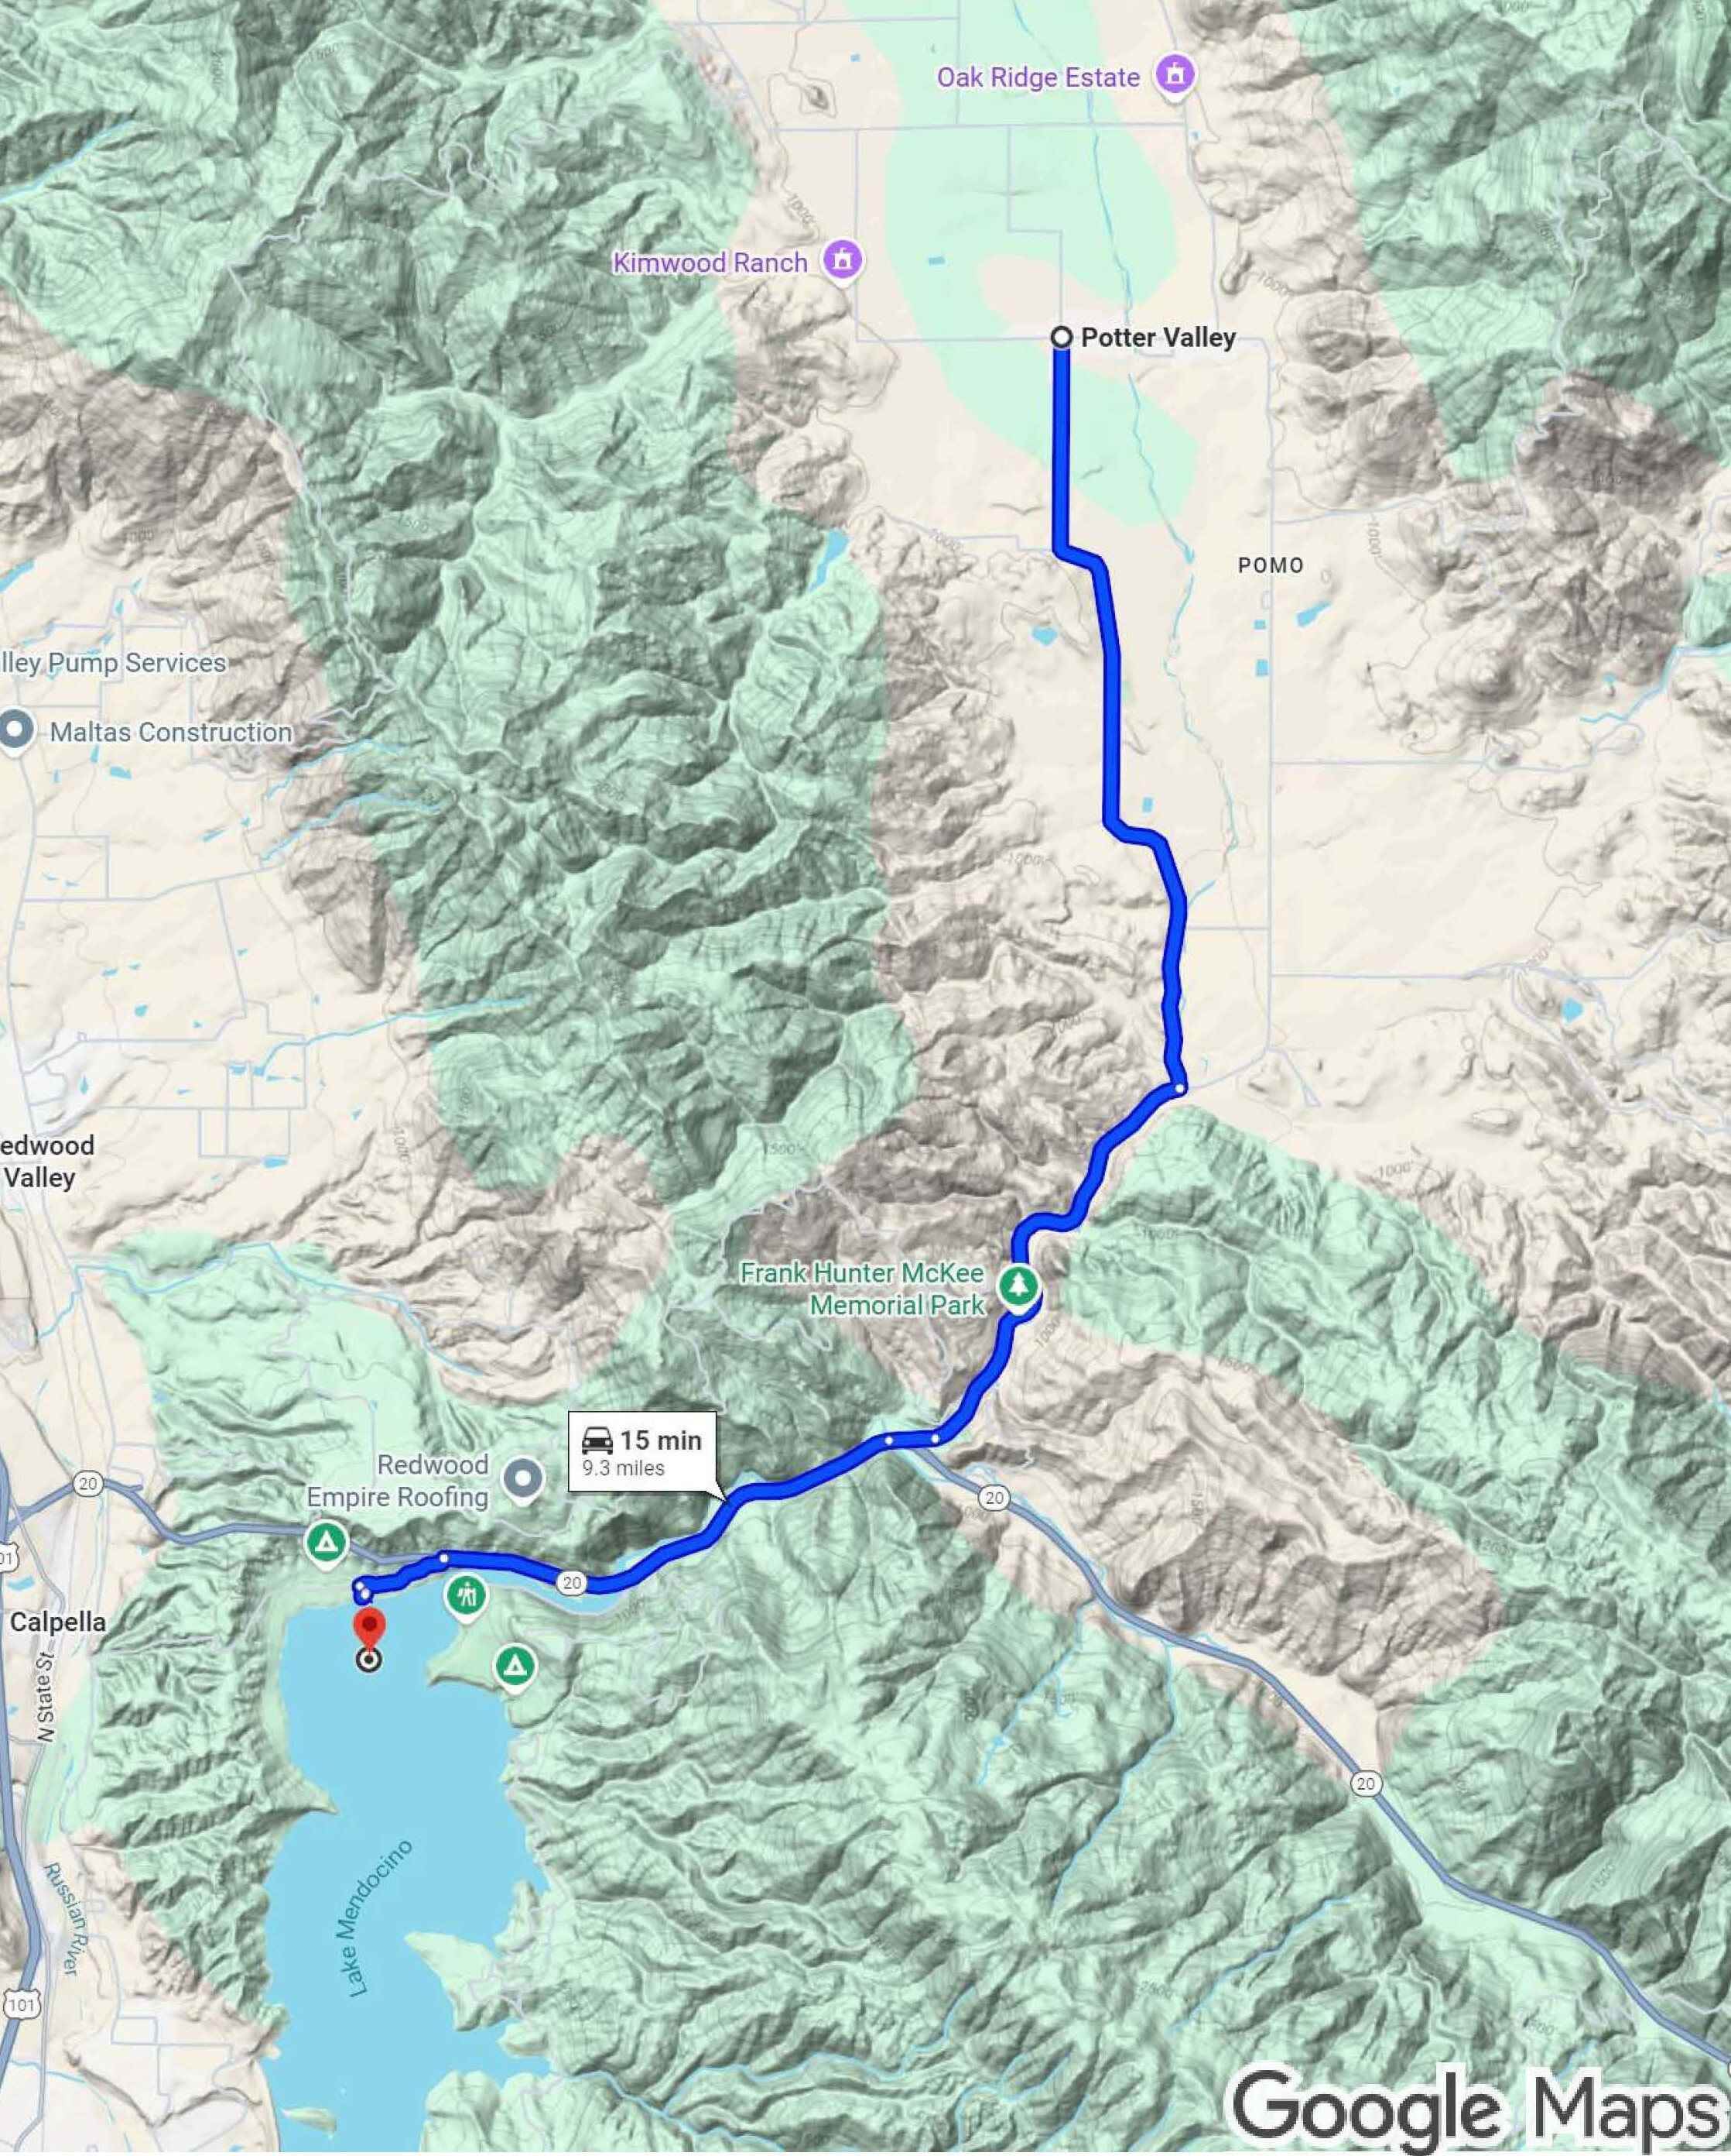
Potter valley Pump Back from Lake Mendocino
10+ mile pipeline, pump station in Lake Mendocino
Can be designed for 10,000 AF yr
Current Lake Mendocino storage is fully subscribed and used, so it will require Lake Mendocino storage expansion or negotiation of existing water rights

Slide 13
Pump Back from Lake Mendocino
Potential Costs, Pros & Cons
Costs:
  Preliminary capital estimate of $100M+
Pros
  Can meet full demand
Cons
  More potential if Lake Mendocino is expanded; far less potential if not
  Utilizes Lake Mendocino: Water rights issues (Lake Mendocino fully subscribed now)
Next Steps & Next Costs
  Engage consultant for next level of design
  First phase $600k - $1000k, next phase $1000k

Slide 14
NEXT STEPs: Storage Alternatives Formulation and ranking
As described, additional investigation is needed for all alternatives
Time and funding are limited, so ranking and prioritization are needed
A viable path forward might include tiers:
  Best apparent potential (cost/benefit), fund and proceed now with additional investigation
  Some potential, fund and proceed when funds are available
  Low potential, no further investigation deemed worthy at this time, put on the shelf

