Slide 1
All-Boards Meeting:
Mendocino County inland water and power commission & Member agencies
May 28, 2025

Slide 2
A. Context: PG&E and the federal energy regulatory commission

Slide 3
Context
PG&E operates the Potter Valley Project (PVP) which moves water from the Eel River Watershed to the Russian River Watershed. All of that water has historically flowed in the Russian and was available for use.
Because the PVP generates power, it is regulated by the Federal Energy Regulatory Commission, which issued it a license to operate.
PG&E has decided to stop operating the PVP because it is cost inefficient and after failing to find someone to purchase the PVP with its license, it has informed FERC that it intends to surrender the license and decommission the PVP. Decommissioning the PVP means removing the dams.
Legally that decision cannot be revisited, and now FERC’s decommissioning process controls.
PG&E is to submit its application to FERC by July 31. That application includes a regional success: the concept that Russian River interests will continue to divert water through the New Eel-Russian Facility (NERF).

Slide 4
B. Proposal for a New Diversion Structure: THE New Eel Russian Facility (NERF)

Slide 5
Proposed Diversion Design and Implementation
With the removal of the PVP dams, the gravity-fed diversion will no longer work. Instead, a new diversion structure is required.
NERF development was led by SWA, supported by IWPC and funded in part by DWR and USBR grants
NERF design and construction will be in close coordination with PG&E’s removal of Cape Horn Dam (CHD)
  Coffer dams and river diversion will be required for both PG&E’s and our efforts.
  Scott Dam fast removal and coffer dam removal will likely be in the same winter season
NERF will allow pumping from 15 cfs up to 300+ cfs, when water is available
Pumping rules vary by season, and include a floor (minimum bypass) then increased pumping allowed as Eel River flow increase
Improvements in powerhouse include a new bypass valve, and control system

Slide 6
Existing diversion

Slide 7
proposed diversion

Slide 8
Existing diversion

Slide 9
proposed diversion

Slide 10
Potential Overall Surrender and Construction Schedule

Slide 11
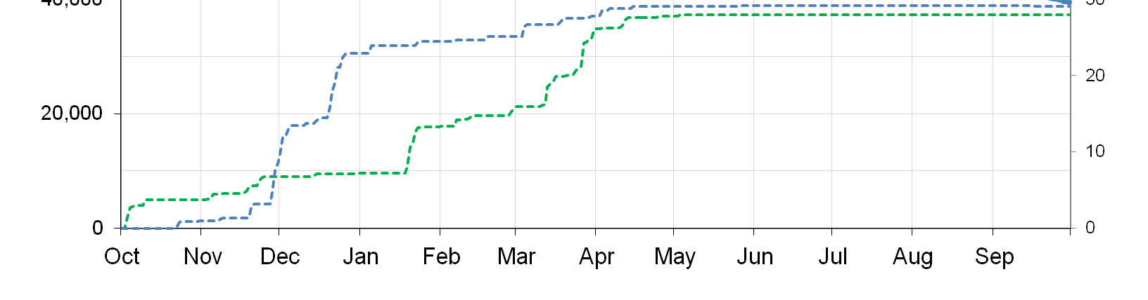
FUTURE DIVERSION POTENTIAL
Over the past decades the amount of water from the Eel has been decreasing due to the Endangered Species Act.
Further, without dams on the Eel River, water through the new diversion structure will be available only in the winter and spring months when sufficient water is flowing.
The Russian River will no longer have the benefit of nearly year-round water flowing into the Upper Russian River
Note how rainfall tends to end in April/May, which will be the end of the season for diversion.
For example: 2012 and 2013 rainfall

Slide 12
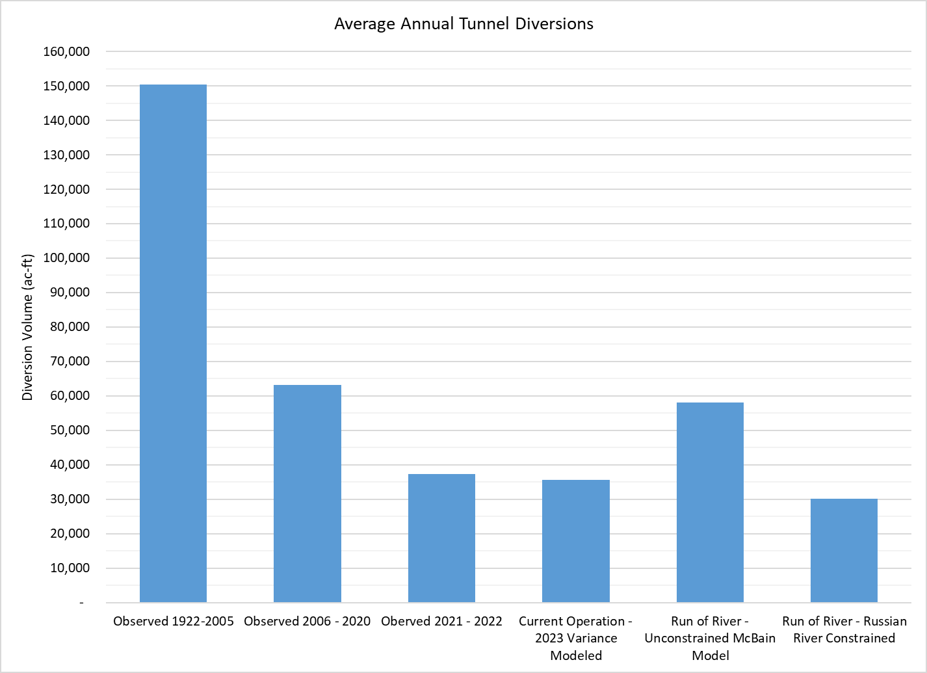
Tunnel Diversion Volumes, Observed (1922 – 2023)
Columns B, C, & D show historic operations in different years.
  Diversions through 2005 averaged approximately 150,000 acre-feet
  Diversions from 2006-2020 averaged approximately 62,000 acre-feet.
  Diversions in 2021 and 2022 averaged approximately 37,000 acre-feet.
Column E shows current operations (approximately 35,000 acre-feet)
NOTE that diversions were significantly reduced before PG&E elected to decommission the PVP
B C D E

Slide 13
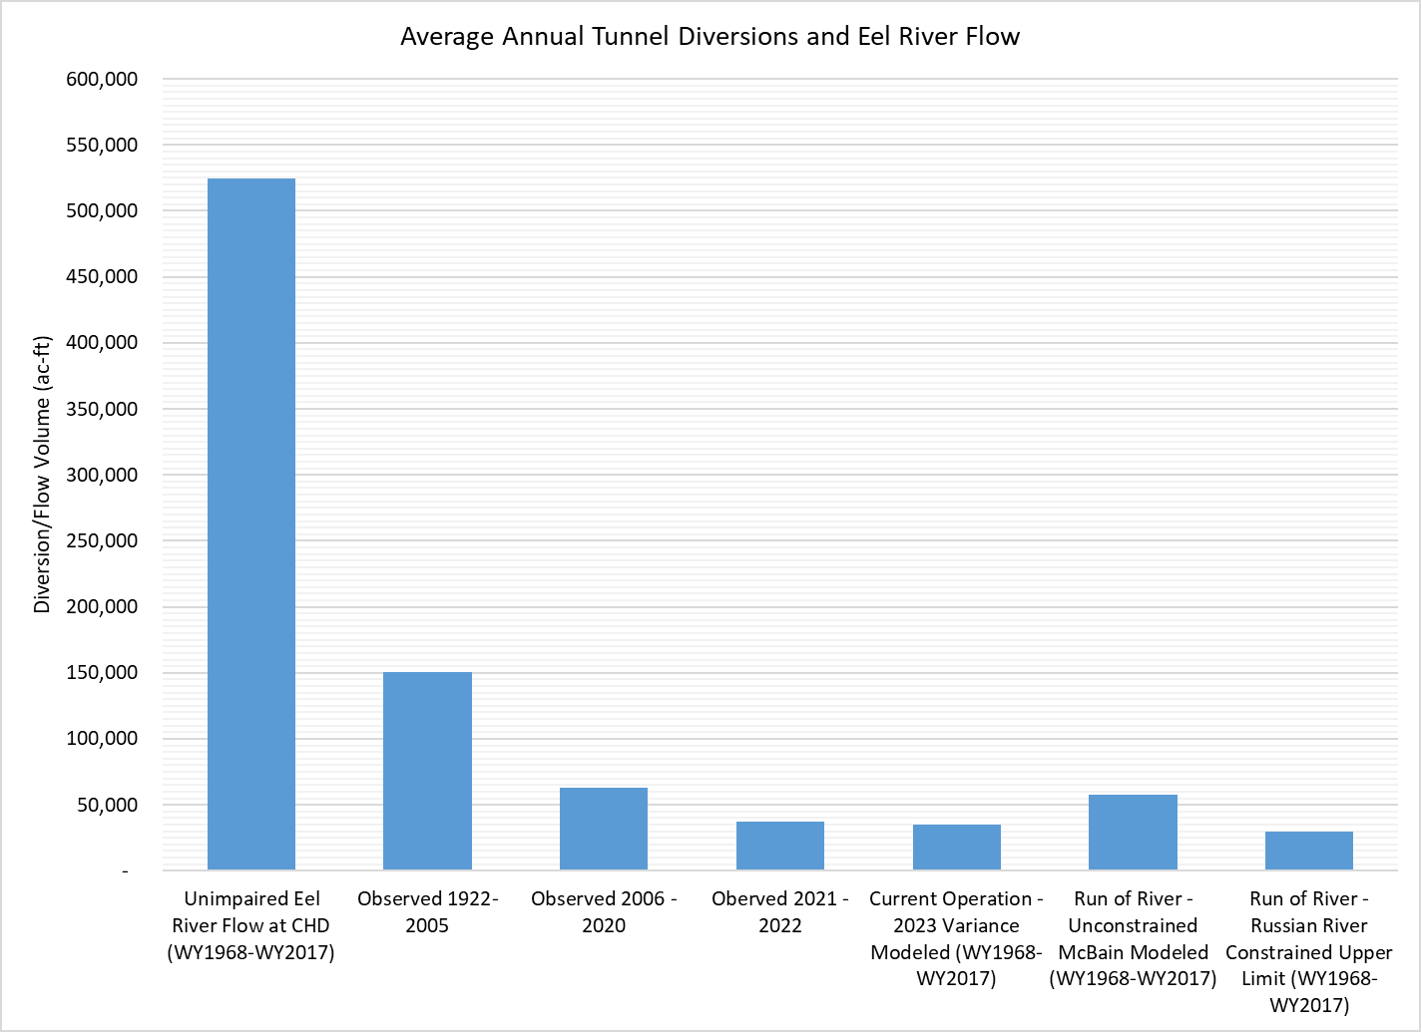
Tunnel Diversion Volumes
AND Proposed Future Diversion
A B C D E F G
Column F shows diversions allowed under WDA criteria.
Column G shows diversions constrained by limited winter storage available in Lake Mendocino and limited year-round storage in Potter Valley
This demonstrates the need for more storage!!!!
Approx 60,000AF
Approx 32,000AF

Slide 14
FUTURE STORAGE NEEDS
Some of the winter diverted water can be stored in Lake Mendocino, but Lake Mendocino storage is limited due to the way in which the Lake is operated.
Water that can be stored in Lake Mendocino when storage space is available will not be available upstream of the reservoir because of the high cost of pumping uphill and water rights issues that would likely make it prohibitive.
Thus, it is necessary to explore how to store winter and spring Eel River water both in and upstream of Lake Mendocino to maximize use in the summer irrigation season.

Slide 15
Categories of New DIVERSION Costs to be Incurred by ERPA
Operation of the diversion structure
Administration and insurance of Eel-Russian Project Authority (ERPA)
Construction of the diversion structure
  Actual construction plus soft costs (engineering, permitting, environmental, etc)
  Public funds and/or bonds to fund the local share of construction costs
Bonds and/or annual costs to fund the cost of storage
Contingency
Other costs - to be determined
  Use fee/forbearance fee to RVIT
  Monitoring costs

Slide 16
Annual ERPA Operational and Financing Assumptions
Operational assumptions:
ERPA will contract with another entity for operation.
Five to eight months of operation per year.
O&M costs includes $750K annually to build reserves.
Financing assumptions:
Construction will be funded through combination of public funds and ERPA bond funds.
NERF construction cost bonds assume ERPA contribution of $20M ($10 to $30M) to supplement public funds.
Storage improvements & bonds assumes ERPA contribution of $35M ($25 to $60M) to supplement public funds.

Slide 17

Potential Annual Cost for ERPA Operations of NERF

Slide 18
Schedule & Key Tasks for ERPA
Interim:
  Commissioning of ERPA
  Design NERF (underway, but need next grant for final design)
  Investigate storage (COE study, consultant for other RR storage options)
  Work with PG&E through FERC process
  Work with PG&E on asset transfer, easement, and other agreements for construction of NERF
Long Term:
  Construction (specs, bid & construct)
  Operations

Slide 19
Expenses & revenue sources - NERF
Interim tasks (NERF) – studies, design & planning, ERPA admin, etc.
  Potential Expenses: $2M to $5M over 4-5 years
  Potential Revenues: membership contributions, grants
Construction of NERF –
  Potential Expenses: $40M to $60M, should be no sooner than 2032
  Potential Revenues: grants, ERPA bonds, membership contributions, other (e.g. assessment)
Operations of NERF and storage –
  Potential Expenses: $7M to $12M per year
  Potential Revenues: water sales, other (e.g. assessment)
NERF costs are pre-design level, but more developed than most estimates

Slide 20
c. The water diversion agreement: framework for the right to divert water

Slide 21
Approach to get to a water diversion agreement
WDA was anticipated to be the document that creates our legal right to divert water
It was needed to justify to PG&E that PG&E should include the NERF in its application
We first developed an MOU to get agreement on the essential terms prior to PG&E’s public draft of its application
Now negotiating a formal WDA to coincide with PG&E’s application that will be binding on the parties and provide a framework of support through the process:
  Russian River interests want reliable, long-term water
  Eel River interests want removal of dams, money for restoration, and confirmation that further diversions will not hurt the endangered species
  PG&E wants to show that the two basins are in agreement (not take sides)

Slide 22
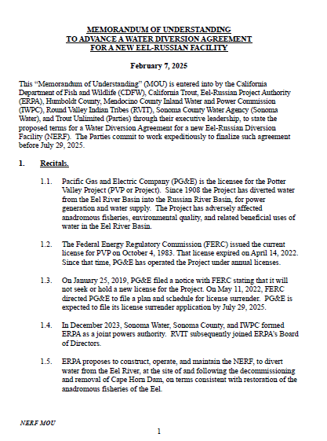
February 7, 2025 MOU between mciwpc, scwa, rvit, ct, tu, hc, and cdfw
Purpose of MOU
Method of permitting vis-à-vis PG&E’s application
Water rights ownership
Land ownership
NERF ownership and operation
Water rights lease (ownership, cost, waiver of sovereign immunity)
Term (30 + 20)
Funding obligations and commitments

Slide 23

July XX, 2025 Water Diversion Agreement
The essential terms have not changed
There has been significant discussion around renewal terms
There is also significant discussion around extent of water rights
We have extensive development of enforcement mechanisms
We are considering the relationships and timing between activities
A more detailed briefing will be provided in closed session
We are on track for execution later this year

Slide 24
d. The need for additional storage of water in the Russian watershed (usace feasibility study and other storage options)

Slide 25
d. The need for additional storage of water in the Russian watershed (usace feasibility study and other storage options)
Federal Project & Study Authority
Federal Funding & Cost-Sharing
USACE Project Delivery Process
USACE Study Overview
USACE Study Milestones
Progress & Next Steps

Slide 26
Federal Project & Study Authority
Existing Project Authority:
  River and Harbor Act of 1950 (P.L. 81-516) authorized Russian River Basin Project
  Includes Coyote Valley Dam as a feature
  Project authority includes flood control, water conservation, and related purposes
  Included “immediate” and “ultimate” flood control plans
New Study Authority:
  Water Resources Development Act of 2016 (P.L. 114-332) authorizes feasibility study of modifications to Coyote Valley Dam
  Investigate addition of environmental restoration and/or increase water supply and improve reservoir operations.

Slide 27
Federal funding & cost-sharing
Feasibility Study Cost-Sharing:
  Requires at least one non-Federal sponsor
  50% Federal / 50% non-Federal cost sharing
  Not a grant
  Cash or in-kind services
Funding:
  Fiscal Year 2024 = $500,000
  Fiscal Year 2025 = $0
  Fiscal Year 2026 = ?
  Tribal Credit = $658,000
Two non-Federal sponsors: MCIWPC
Lytton Rancheria
Study Budget Estimate:
Current Capacity = $1,316,000
FCSA = $3,000,000
Estimated = $6,500,000

Slide 28
USACE Project delivery process
Feasibility Study
Construction
Operations and Maintenance
Preconstruction Engineering and Design
USACE produces a feasibility study and associated NEPA document.
Phase concludes with a Chief’s Report which recommends a project to Congress
Congressional approval is required for construction.
USACE initiates engineering and design while waiting for Congressional approval.
Design activities subject to receipt of appropriations.
Requires non-Federal sponsor and an executed Design Agreement.
USACE oversees project construction through one or more construction contracts.
Requires Congressional authority and “new start” appropriations.
Requires non-Federal sponsor and an executed Project Partnership Agreement (PPA).
USACE or non-Federal sponsor assumes O&M responsibility after construction.
USACE retains O&M responsibility for navigation and multi-purpose dams.
Other project types are transferred to non-Federal sponsor for O&M responsibility.
Anticipated Duration:
3 to 5 years
Anticipated Duration:
2 to 3 years
Anticipated Duration:
4 to 8 years
Anticipated Duration:
N/A

Slide 29
USACE Study Overview
Scoping & Alternatives Identification
Selected Plan Development
Final Report Processing
Alternatives Evaluation & Analysis
Problems, opportunities, objectives, and constraints identified.
Detailed scope of work, budget, and schedule developed for USACE / Sponsor approval.
Initial array of alternatives identified for evaluation and comparison.
Existing conditions established as baseline.
Alternatives developed to sufficient level of detail to evaluate and compare.
Comparison results in selection of preferred alternative or “tentatively selected plan” for USACE / Sponsor support.
Draft Feasibility Study released tech / agency / public review.
Tentatively Selected Plan (TSP) becomes Recommended Plan.
Recommended Plan is further developed to improve certainty of implementation cost, project performance and benefits, and environmental impacts.
Draft Final Feasibility Report transmitted to Washington DC for processing.
Draft Chief of Engineer’s Report developed for Agency / State review.
Final Chief of Engineer’s Report submitted to Congress for authorization.
Anticipated Duration:
4 to 8 months
Anticipated Duration:
14 to 21 months
Anticipated Duration:
12 to 21 months
Anticipated Duration:
6 to 10 months

Slide 30
USACE Study Milestones
Scoping & Alternatives Identification
Selected Plan Development
Final Report Processing
Alternatives Evaluation & Analysis
Execute
FCSA
Mar 25 (a)
Alternatives Milestone
Oct 25 (est.)
Tentatively Selected Plan Milestone
Command
Validation Milestone
Draft Final Study Transmitted to
HQUSACE
Final Chief’s Report to Congress
Planning Charrette
Jul 25 (est.)
Vertical Team Alignment Memo
Dec 25 (est.)
Draft Study Public Review
Agency / State Review of Draft Chief’s Report
NF Sponsor
Support?
NF Sponsor
Support?
NF Sponsor
Support?

Slide 31
Progress & next steps
Progress:
  Initial Federal funding received in FY 2024
  Lytton Rancheria agreed to serve as joint non-Federal sponsor in February 2025
  Local Agreement executed w/ Lytton Rancheria in March 2025
  Feasibility Cost-Sharing Agreement (FCSA) executed in March 2025
Next Steps:
  Schedule Planning Charrette w/ USACE for June / July 2025
  Advance scoping w/ USACE
    Strong orientation toward new water storage including (and beyond) Coyote Valley Dam
    Independent validation / expansion of technical work commissioned by IWPC
    Define initial work product non-Federal sponsors can use to determine continued participation

Slide 32
e. Next steps: likely costs, needed actions, and timing

Slide 33
We are traveling along a path
Built a coalition to support continued diversion
Convinced PG&E to support the coalition’s proposal
Obtained grants to plan and design a new diversion structure
Got DWR grant to study groundwater in Potter Valley
Negotiating a Water Diversion Agreement to confirm diversion plan
Starting a Federal study for Lake Mendocino raise and other storage
Prepare a CEQA document to support construction
Work on Lake Mendocino study
Explore other storage opportunities
Participate in FERC proceeding
Raise funds to ramp up activity

Slide 34
Categories of interim Costs for IWPC
IWPC/ERPA overhead costs
Coyote Valley Dam Feasibility Study cost share
Coyote Valley Dam Feasibility Study consultant costs
Financing costs (consultant to pass an election; bonding costs)
Support for existing grant from USBR
Potter Valley groundwater assessment (capital, O&M, grant admin, consultant costs)
Potter Valley Project transaction with PG&E
Permitting and data collection
Water Diversion Agreement process

Slide 35
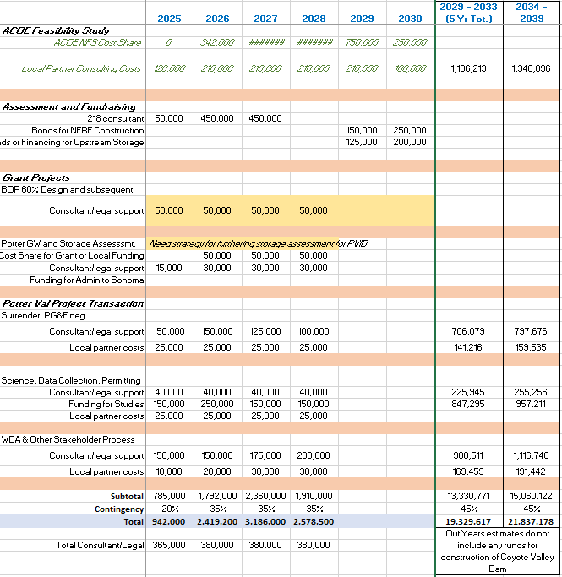
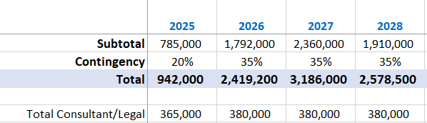

Slide 36
Next few steps
IWPC needs to finish negotiations on the WDA
IWPC and SWA need to negotiate water allocation and financial responsibility
IWPC needs to engage with Lytton and USACE on Lake Mendocino Study
IWPC member agencies need to review IWPC structure and ensure it is adequate for future needs
ERPA needs to develop a staffing and funding model
IWPC needs to develop a funding model
We all need to be ambassadors to advance this effort and secure water for the region’s future.

Slide 37
Closed session

